Slide 1

Building a FLASK APPLICATION For online management of healthcare centers
Abir Biswas

Slide 2


Agenda
Understanding Flask Routing
Working with Databases
Server Handling
Authorization and Management of Unique client requests
Security

Slide 3



Introduction
Welcome and overview of the Health Care Center flask application
Purpose of the project: to provide a platform for hospitals to manage patient details efficiently

Slide 5

Why Flask ?
It provides a simple and lightweight way to create web applications in Python, allowing developers to quickly build and deploy web applications with minimal overhead.

Slide 6
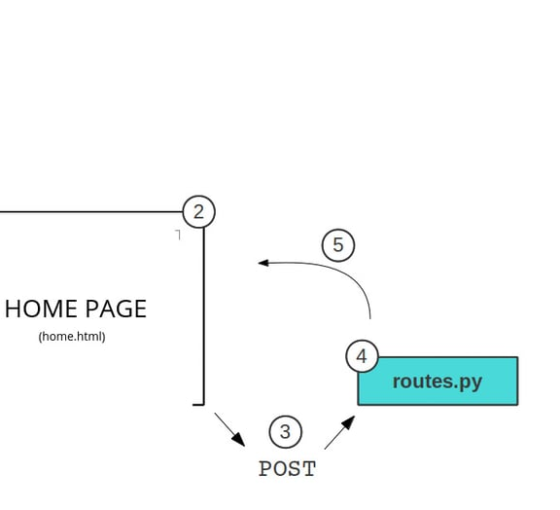
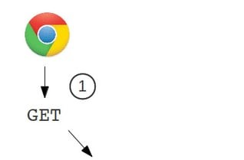
Routing Protocols
Defining Routes in Flask
Handling requests
View Functions

Slide 7
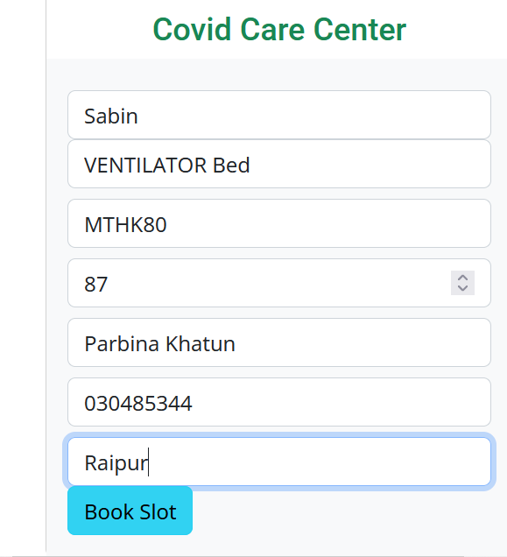
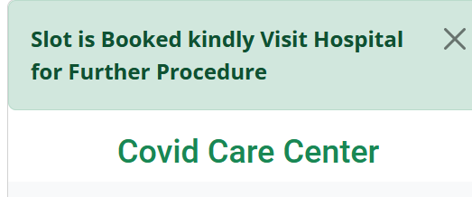
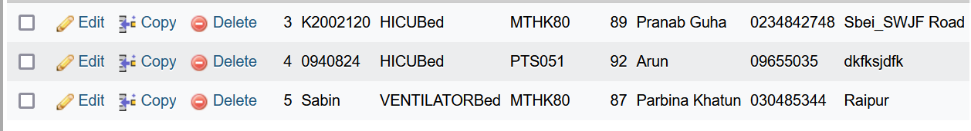
Managing Database in Flask Application
Utilizing Flask-SQLAlchemy

Slide 8
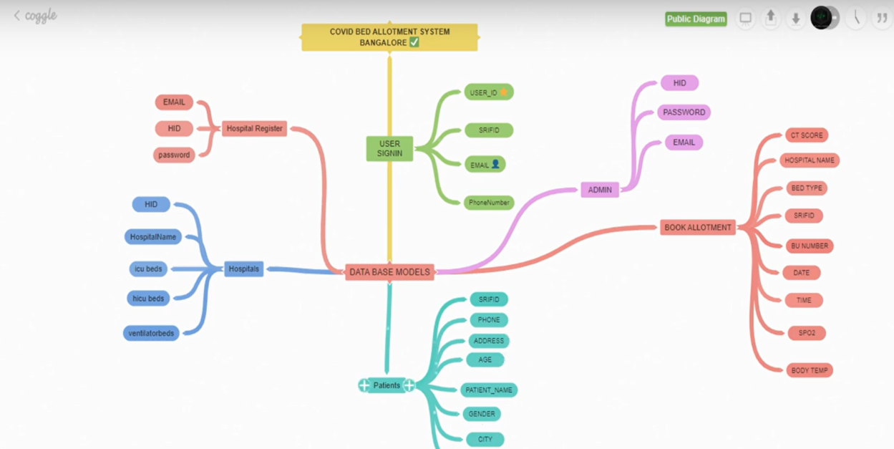
Flowchart For Database Model

Slide 9
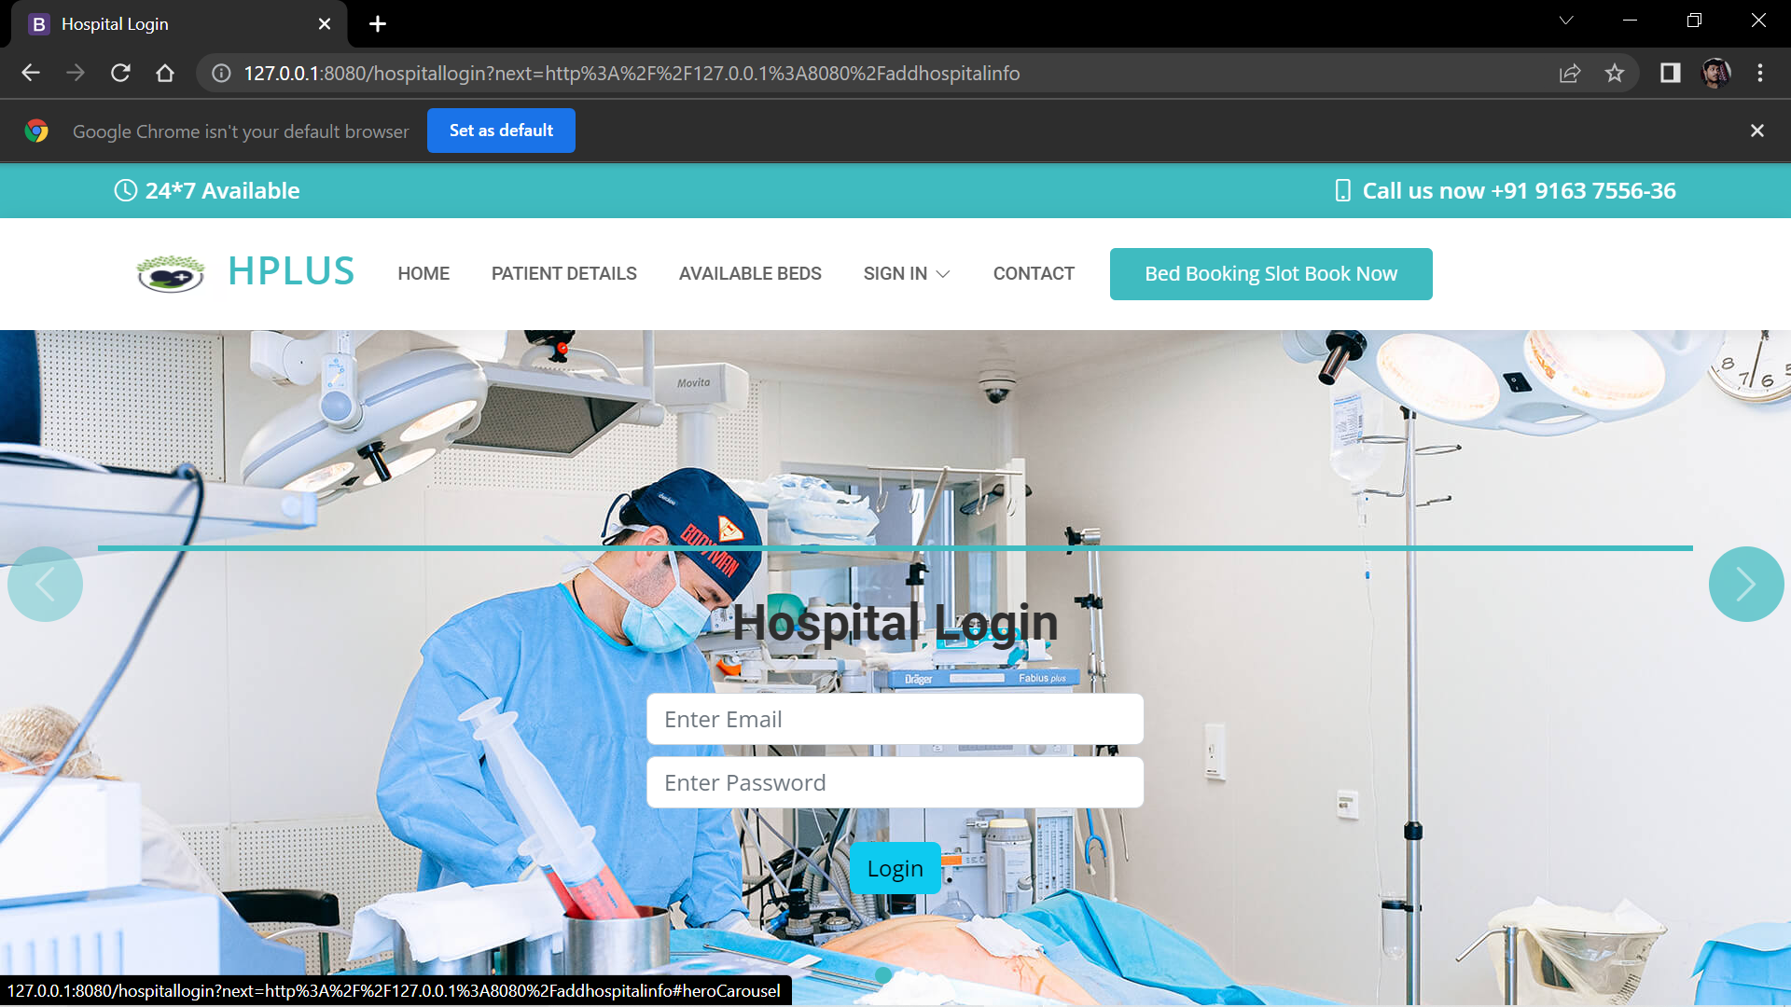
Server-client connection
Our system allows for unique client requests to the server and authorizations in order to cater to the specific needs of individual clients.
Benefits:
Flexibility to handle specific client requirements.
Enhanced security by verifying client authorization before granting access.
Scalability to handle a large number of unique client requests.

Slide 10
Ensuring Security
We have Committed to protect client data, building trust and confidence among our
clients.
We use industry-standard libraries such as Werkzeug in Python to securely hash and verify passwords.
We ensure that passwords are not stored in plaintext and are resistant to attacks like rainbow table attacks
and brute force attacks.
In addition to password hashing, we also implemented other security measures in our system, such as using
HTTPS, implementing strong authentication mechanisms, and regular security audits.
We follow the principle of least privilege, ensuring that only authorized users have access to sensitive
information or actions.
We also regularly update and patch our system to address known security vulnerabilities and stay protected
against emerging threats.

Slide 11


The way to get started is to quit talking and begin doing.
Walt Disney

Slide 12
team
Abir Biswas
Binay Borun Mann
Rahul

Slide 13
Timeline
Main Routes
Form Handling
Enabled password hashing functions for secure authentication and protect the database from rainbow table
ORM
Database management using SQLAlchemy’s Object Relational Mapping (ORM) for CRUD operations, including creating, reading, updating and deleting data from MySQL database
Session Management
Used Flask’s login_required decorator for secure user sessions
Dealing with main routes in the web application, including home, signup, hospital login, admin and logout
Built forms with user-friendly interface for getting unique user login credentials with advanced security
Secure Authentication
Sample Footer Text
20XX
13

Slide 14
Technologies Used
Modules
Additional Modules and Extensions
Flask: Python web framework for building the
backend
MySQL: Database management system for
storing user data
Flask-Mail: Extension for sending emails
Werkzeug: Library for password hashing and
authentication
Jinja2: Templating engine for rendering HTML
templates
HTML/CSS: Frontend markup and styling
Bootstrap: CSS framework for responsive
design

Slide 15
Useful Links
Resources
Manage links
Google Cloud MySQL (host=localhost/instance-1, user= root, password=[None], port: 8080)
N2D AMD Instance and Confidential Computing
Compute Engine VM instance(boot disk image: ubuntu-pro-fips-2004-focal-v20230302)
Cloud-storage Bucket(dbms-bucket)
Github Repository:
https://github.com/ALphastrEAM5/hplus.git
Website: 127.0.0.1:8080
N.B: Before running the website on localhost of your PC import “covid.sql” file from the github repo to your local Xampp server

Slide 16




Summary
This Flask app is a feature-rich hospital management system that includes functionalities for user login and validation, email notifications, PDF report generation, and logout functionality. It is designed to cater to the needs of hospitals and administrators, providing a seamless and intuitive user experience for managing various aspects of hospital operations, such as patient records, appointments, and bed slots.

Slide 17

Thank you
Presenter name- Abir Biswas
Email address- abir20522@iiitkalyani.ac.in

